Slide 1
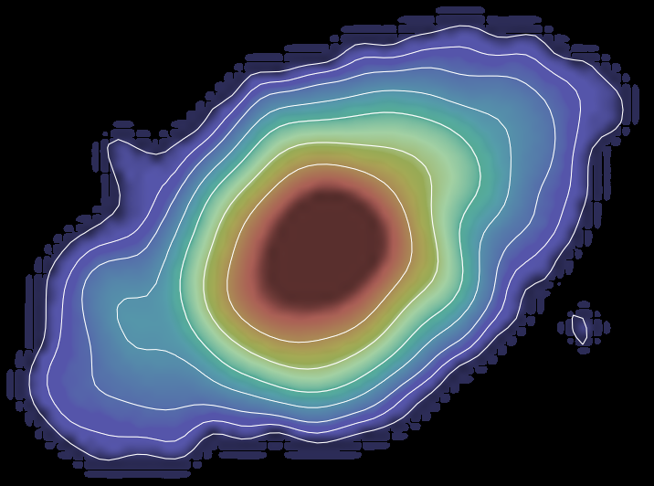
Varenius, E.
(OSO-Chalmers)
Pérez-Torres, M.Á.
(IAA-CSIC)
Conway, J.
(OSO-Chalmers)
Alberdi,A.
(IAA-CSIC)
Herrero-Illana, R.
(IAA-CSIC)
Naím Ramírez-Olivencia
(IAA-CSIC)
EVN imaging of the LIRGI sample

Slide 2
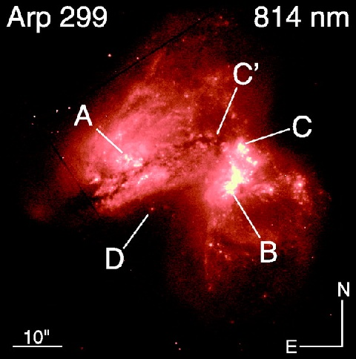
LIRGs
LIRGs
$${10}^{11}L_{⨀}<L_{IR}<{10}^{12}L_{⨀}$$
ULIRGs
$$L_{IR}>{10}^{12}L_{⨀}$$
Interacting galaxies
AGN vs. starburst
Neff et al. 2004

Slide 3
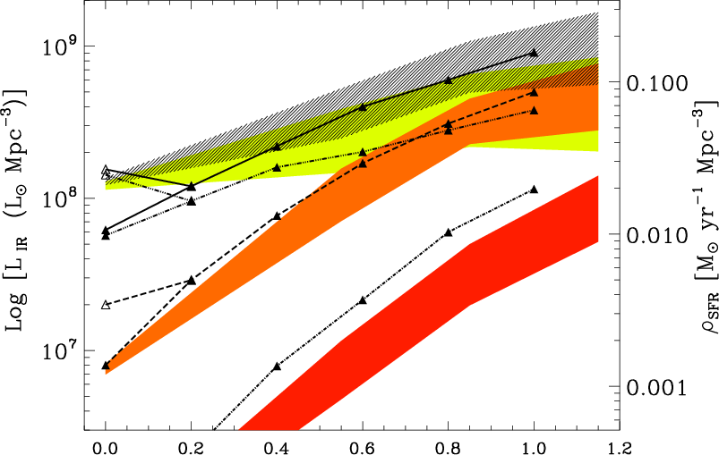
LIRGs
Magnelli et al. 2009
Normal
LIRGs
ULIRGs
Redshift

Slide 4
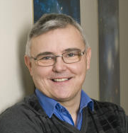
Luminous InfraRed Galaxies Inventory (LIRGI)
eMERLIN legacy survey
J.Conway & M.Á.
Pérez-Torres
Notes:
In an effort to make a significative sample of these galaxies

Slide 5
Luminous InfraRed Galaxies Inventory (LIRGI)
Susanne Aalto | Onsala Space Observatory, Chalmers, Sweden
Antxon Alberdi | IAA-CSIC, Granada, Spain
Phil Appleton | NASA Herschel Science Center, Caltech, USA
Willem Baan | ASTRON, The Netherlands
Fabien Batejat | Onsala Space Observatory, Chalmers, Sweden
Rob Beswick | JBCA, Manchester, UK
Luis Colina | DAMIR, Madrid, Spain
John Conway | Onsala Space Observatory, Chalmers, Sweden
Francesco Costagliola | IAA-CSIC, Granada, Spain
Phil Diamond | JBCA, Manchester, UK
Denise Gabuzda | University College Cork, Ireland
Simon Garrington | JBCA, Manchester, UK
Rubén Herrero-Illana | IAA-CSIC, Granada, Spain
Hans-Rainer Klockner | Oxford, UK
Colin Lonsdale | MIT, Cambridge, USA
Iván Martí-Vidal | Onsala Space Observatory, Chalmers, Sweden
Sebastien Muller | Onsala Space Observatory, Chalmers, Sweden
Carole Mundell | John Moores University, Liverpool, UK
Ray Norris | CSIRO, Australia
Miguel Ángel Pérez-Torres | IAA-CSIC, Granada, Spain
Naím Ramírez-Olivencia | IAA-CSIC, Granada, Spain
Rodrigo Parra | ESO, Chile
Ylva Pihlström | University of New Mexico, USA
Mónica Rodríguez | IAA-CSIC, Granada, Spain
Cristina Romero-Cañizales | IA, Pontificia Universidad Catolica, Chile
José-María Torrelles | CSIC-IEEC, Barcelona, Spain
Eskil Varenius | Onsala Space Observatory, Chalmers, Sweden
J.Conway & M.Á.
Pérez-Torres
Notes:
Almost 30 people

Slide 6
Luminous InfraRed Galaxies Inventory (LIRGI)
eMERLIN legacy survey
J.Conway & M.Á.
Pérez-Torres
42 (7 already observed) of the most Luminous northern LIRGs
(8 ULIRGs)
Notes:
42 of the most Luminous northern LIRGs
(8 ULIRGs)

Slide 7
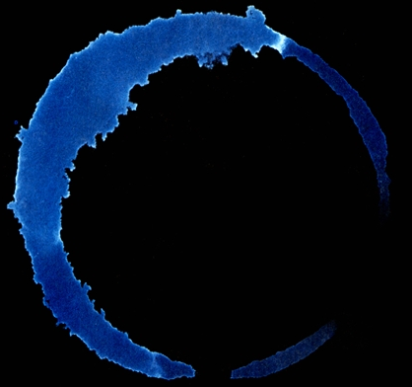
Luminous InfraRed Galaxies Inventory (LIRGI)
IRAS
GOALS
LIRGI

Slide 8
Luminous InfraRed Galaxies Inventory (LIRGI)
eMERLIN legacy survey
J.Conway & M.Á.
Pérez-Torres
42 (7 already observed) of the most Luminous northern LIRGs
(8 ULIRGs)
$$\log\left(L_{IR}/L_{⨀}\right)>11.4$$
D < 250 Mpc

Slide 9
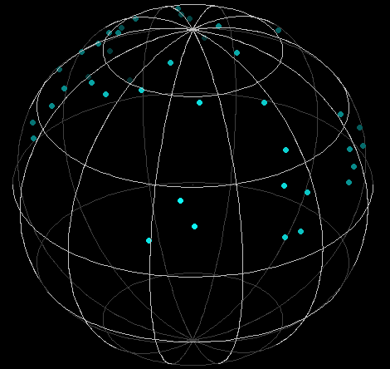
Luminous InfraRed Galaxies Inventory (LIRGI)
$$δ>8°$$

Slide 10
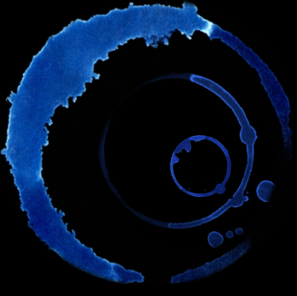
Luminous InfraRed Galaxies Inventory (LIRGI)
eMERLIN legacy survey
J.Conway & M.Á.
Pérez-Torres
42 (7 already observed) of the most Luminous northern LIRGs
(8 ULIRGs)
$$\log\left(L_{IR}/L_{⨀}\right)>11.4$$
D < 250 Mpc
$$δ>8°$$
http://lirgi.iaa.es

Slide 11
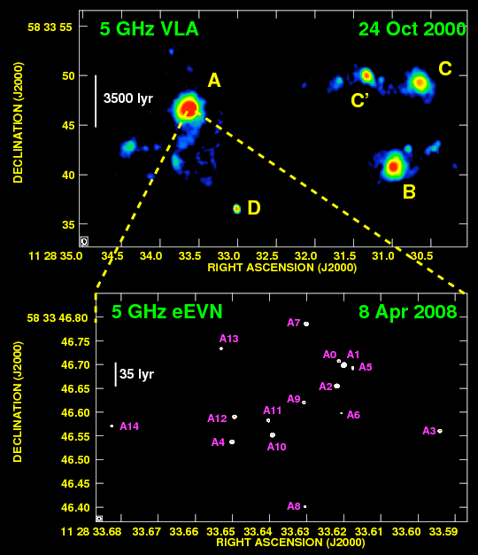
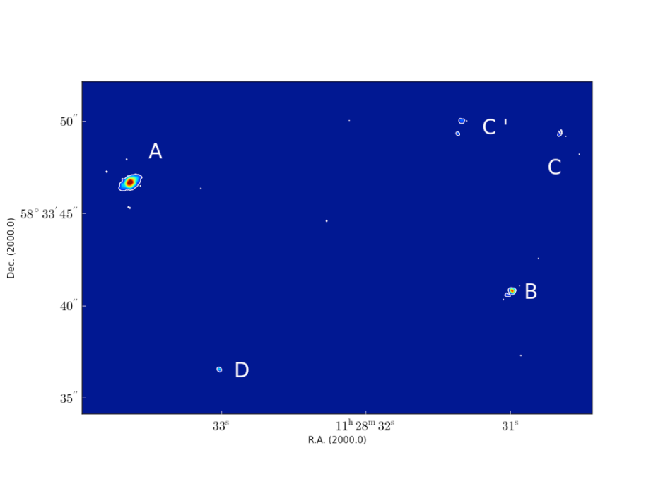
LIRGI observations
Diffuse emission
Compact Sources
Pérez-Torres et al. 2009
Herrero-Illana et al. 2013 - ATel
eMERLIN
EVN
Notes:
Multi-Element Radio Linked Interferometer Network (MERLIN)

Slide 12
Science Behind LIRGI with eMERLIN
Map diffuse radio emission
Trace the free-free absorption with high resolution
Measure magnetic field strengths
Obtain dynamical masses
Spatial variations in chemistry and physical conditions

Slide 13
Science behind LIRGI with EVN
PI: M.Á.Pérez-Torres
Contribution of AGNs and starbursts
Detection and measurement of Supernova Remnants (SNRs)
Core Collapse Supernova (CCSN) rate

Slide 14
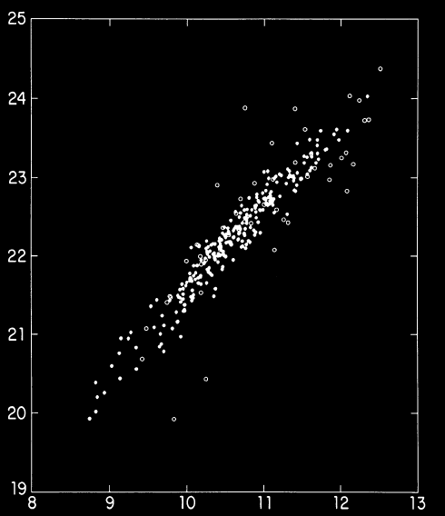
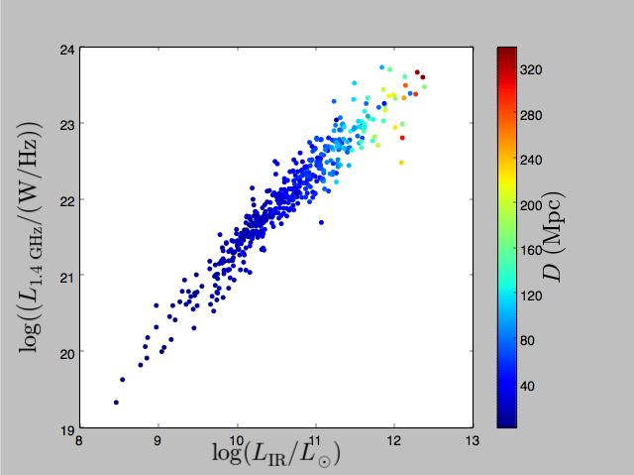
IR/radio relation (LIRGI)
Yun et al. 2001

Slide 15
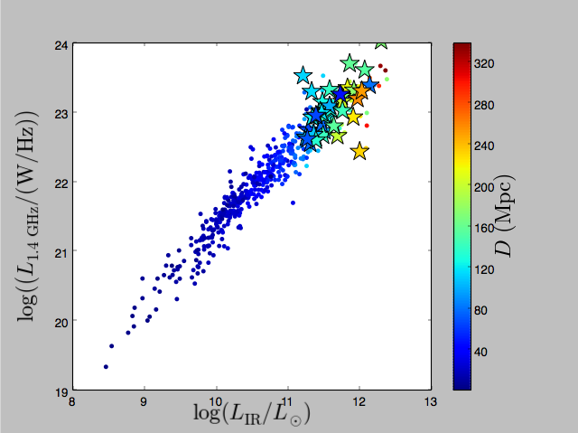
IR/radio relation (LIRGI)
Yun et al. 2001

Slide 16
LIRGI observing requests for EVN
Contemporaneous C- and L-band
1 Gb/s
Off source rms$≤$10$μJy/beam$ both bands
Integration time $≃80m$
Mutiple pointings, multiple correlations

Slide 17
LIRGI observations with EVN
Experiments: EP076 (A,B,C,D) and EP088(A,B,C,D).
Incoming EP088(E,F)
EP088(G,H) to observed this October
Antennas observing :
Effelsberg
Westerbork
Jodrell Bank (Lovell)
Onsala
Medicina
Torun
Yebes (Cband)
Svetloe
Zelenchukskaya
Badary
Urumqui
Shangai
Hartebeesthoek

Slide 18
LIRGI observations with EVN
Sources obtained:
MRK0331
MCG+12-02-00
III ZW035
IRAS03359+15
IC5298
NGC2623
NGC5256
NGC7674
IRASF17132
IRAS10565
VV340
CGCG448
IRASF15250
NGC6090
NGC6670
NGC0695
VV250
VV705
18/35 LIRGs in LIRGI!
(12 reduced)

Slide 19
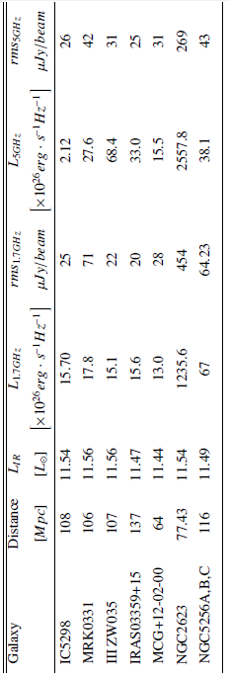
LIRGI observations with EVN
EP076 (A,B,C,D)(session 3, 2012)

Slide 20
LIRGI observations with EVN
EP088 (C ,D)(session 1, 2014)

Slide 21
LIRGI observations with EVN
Galaxy | L-band | C-band
IRASF10565
VV340A
CGCG448
NGC6670
IRASF15250
IC5298
MRK0331
III ZW035
IRAS03359+15
MCG+12-02-00
NGC2623
NGC5256A
Typical values: ${10}^{27}−{10}^{28}$ $erg∙s∙{Hz}^{−1}$
Associated luminosity with rms: $<{5⋅10}^{25}erg∙s∙{Hz}^{−1}$

Slide 22
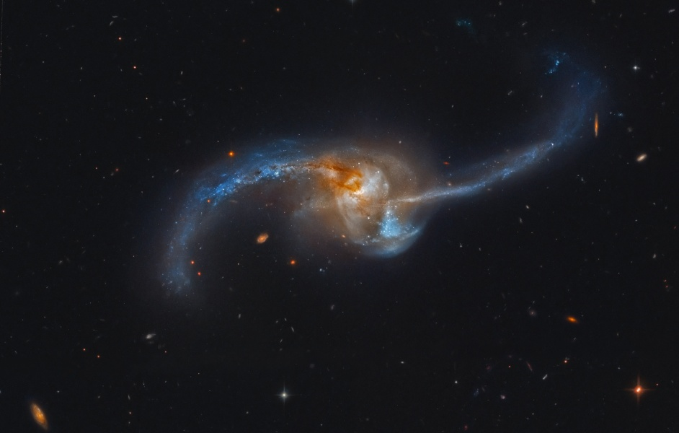
LIRGI observations with EVN
NGC2623
55kpc
16kpc
$$\log\left(L_{IR}/L_{⨀}\right)=11.54$$
D=79 Mpc
Notes:
LINER, Sy2

Slide 23
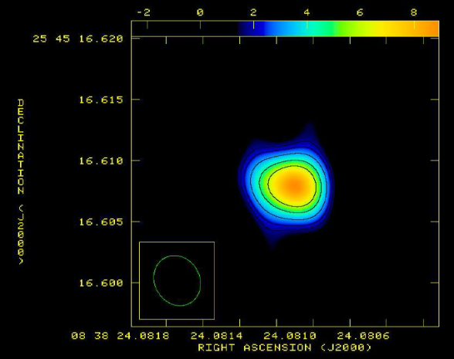
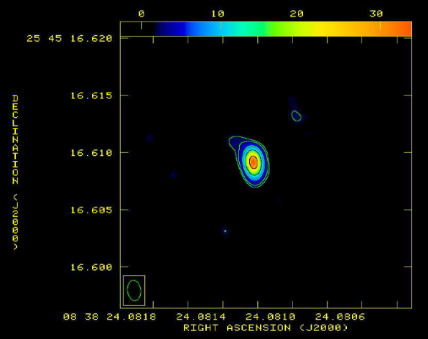
LIRGI observations with EVN
NGC2623
$$SFR\sim 60M_{⨀}/yr$$
55kpc
$$CCSN rate∼1 CCSNe/yr$$
$$α_{L}^{C}=0,67$$
16kpc
$$L_{1.7GHz}=1,2⋅{10}^{29}erg⋅s^{−1}⋅{Hz}^{−1}$$
$$L_{5GHz}=2,6⋅{10}^{29}erg⋅s^{−1}⋅{Hz}^{−1}$$
$$\log\left(L_{IR}/L_{⨀}\right)=11.54$$
D=79 Mpc
2.3pc
1.7pc
L-band
C-band

Slide 24
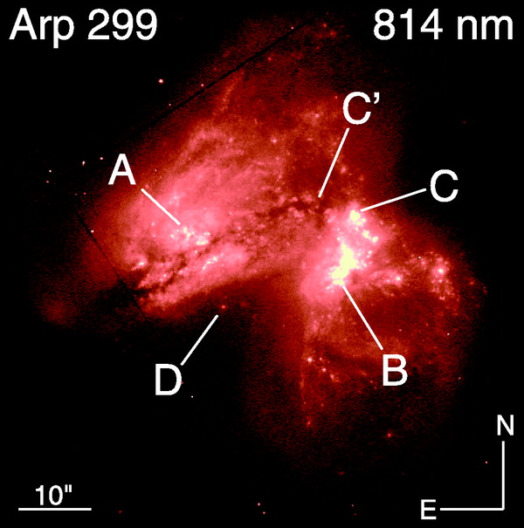
LIRGs:
ULIRGs:
Provide ~10% of radiant energy production in the local universe
Provide ~ 20% of all the high-mass SF in the local universe
Contain millions of OB stars: test massive star evolution, IMFs,...

Slide 25
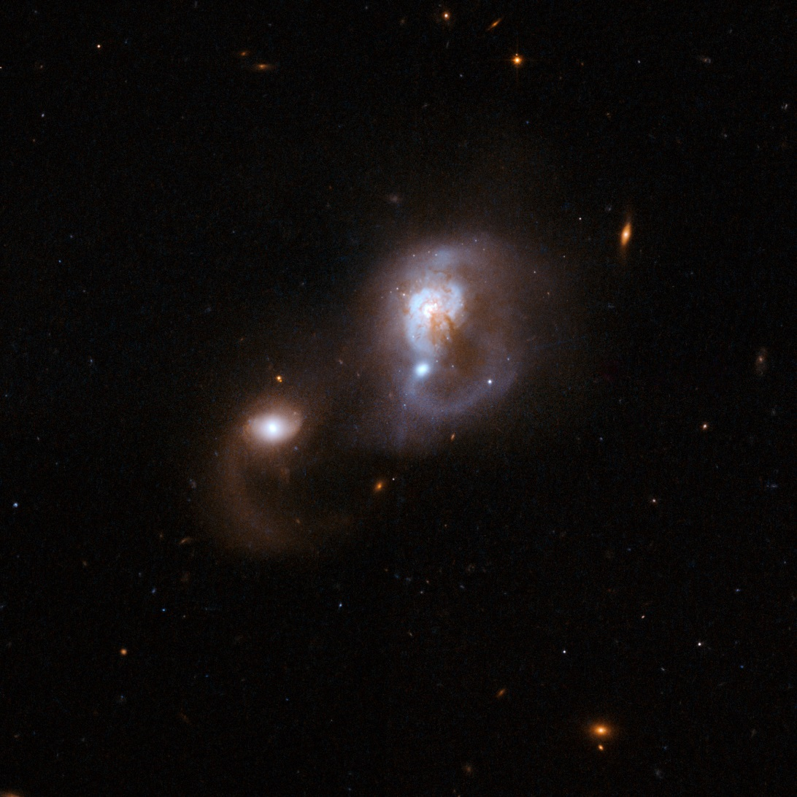
LIRGI observations with EVN
IRASF10565+2448
36 kpc
31 kpc
D=190 Mpc
$$\log\left(L_{IR}/L_{⨀}\right)=12.02$$

Slide 26
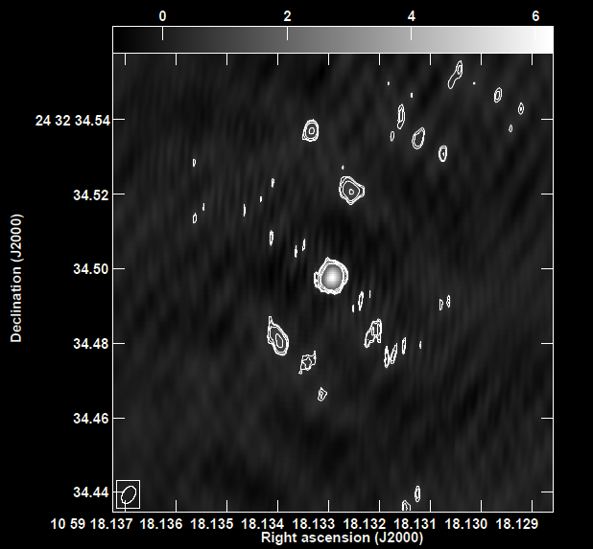
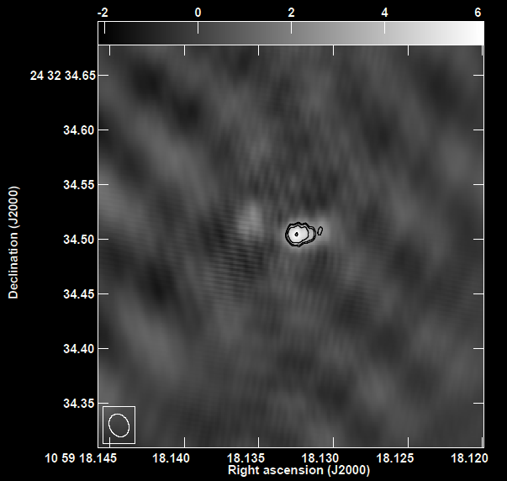
LIRGI observations with EVN
C-band
IRASF10565+2448
36 kpc
9pc
31 kpc
L-band
26,8pc
D=190 Mpc
$$\log\left(L_{IR}/L_{⨀}\right)=12.02$$

Slide 27
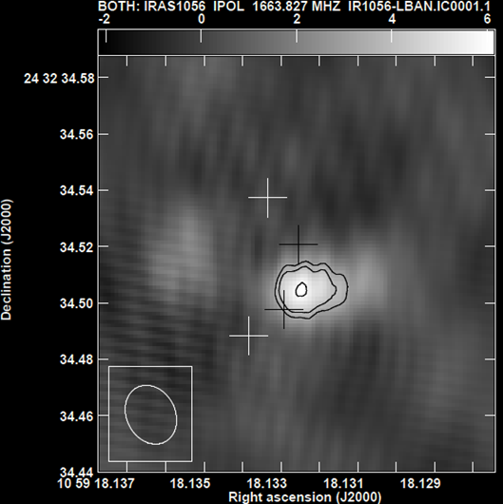
LIRGI observations with EVN
$α_{L}^{C}$=-1,3
$α_{L}^{C}$=1,51
$$SFR\sim 190M_{⨀}/yr$$
$$L_{1.7GHz}=2,4⋅{10}^{29}erg⋅s^{−1}⋅{Hz}^{−1}$$
rms$=395 μJy/beam$
$$L_{5GHz}=2,4⋅{10}^{29}erg⋅s^{−1}⋅{Hz}^{−1}$$
rms$=78 μJy/beam$
$$CCSN rate∼3 CCSNe/yr$$
4
3
1
2
AGN
$α_{L}^{C}$=0,6
L-band
$α_{L}^{C}$=0,02

Slide 28
Summary
Observations of high resolution at radio wavelenghts of 18/35 LIRGs of the LIRGI survey
Detections at both bands:
L band: 2
C band: 3
Both bands: 3
rms ~25-30 $μ$Jy/b, about twice the expected value
Detection of compact components with values of a few times 10^27 erg/s/Hz, typical of SNe and/or SNRs

Slide 29
Summary
Good detection of at least 2 AGNs (evidence both in the espectral index and luminosity)
Overall, our current EVN observations show evidence for:
AGN dominated nuclear sources (e.g. NGC 2623)
Mixing of SB and AGN activity (e.g., IRAS10565+2448)
SB-dominated sources (several non-detections => diffuse synchrotron emission)

Slide 30
Bottom lines
local universe
eMERLIN will eventually trace the diffuse radio emission of the kpc scale regions
LIRGI EVN is already showing the existence of compact components (AGNs as well as CCSNe/SNRs) that will help to characterize the innermost 100 pc regions of LIRGs and ULIRGs

Slide 31
Future Work with LIRGI
Remaining 17 U/LIRGs.
Incoming observations with eMERLIN
Improvement of the last epoch images
Complete the catalog with new information (SNRs, AGN (yes/no), spectral index)
Offer the complete legacy project for the scientific community

Slide 32
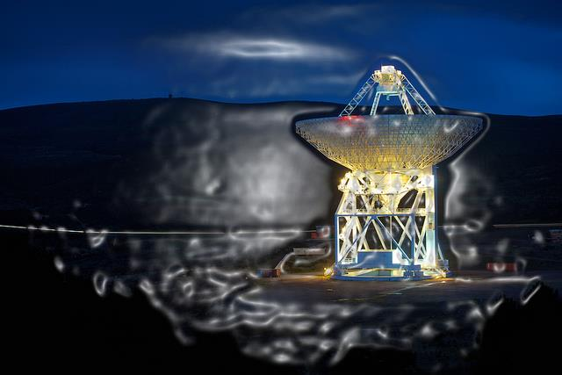
THANK YOU!

Slide 33
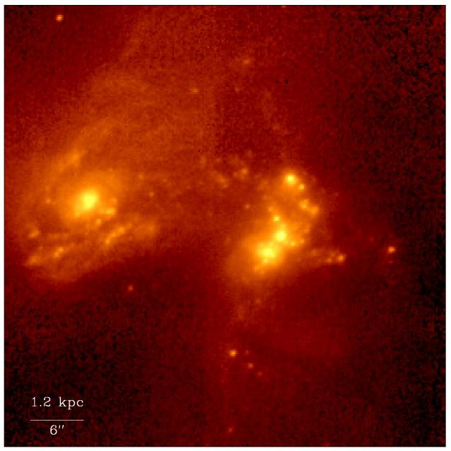
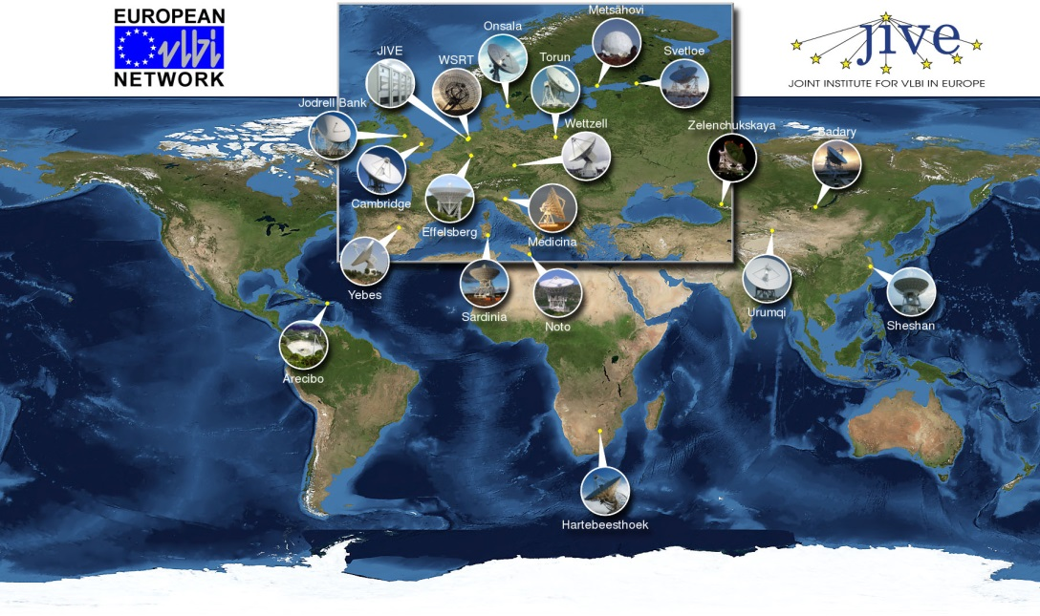
EVN Tool for Astronomy
U/LIRGs

Slide 34
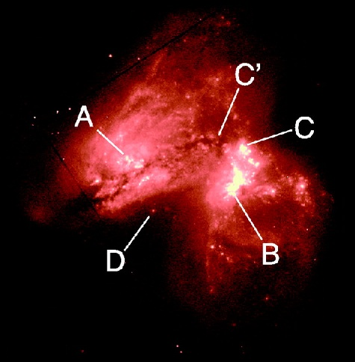
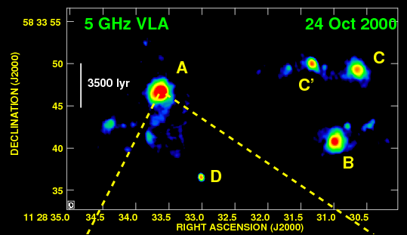
LIRGs at Radio Wavelengths

Slide 35
Science Behind LIRGI
-
Tracing SF via radio continuum requires a deep understanding of these sources: radio to IR correlation? Stable IMF?

Slide 36
Luminous InfraRed Galaxies Inventory (LIRGI)
2.GOALS
… included in the well studied GOALS survey (180 U/LIRGs). It spans the range of different types of AGNs and starbursts at different wavelengths. http://goals.ipac.caltech.edu/
3.IRAS Revised bright galaxy sample:
… and the GOALS galaxies belong to the IRAS-Bright Galaxy Sample (Sanders et al. 2003), which includes 629 brightest 60-micron extragalactic sources in the whole sky.
1.LIRGI:
42 galaxies with log(${L_{IR}}/{L_{⨀}}$) >11.4
- D_{max} = 250 Mpc
- Dec > 8 deg
http://lirgi.iaa.es/
J.Conway & M.Á.Pérez-Torres
42 of the most Luminous northern LIRGs
$$\log\left(L_{IR}\right)>11.4$$
D < 250 Mpc
$$δ>8°$$

Slide 37
Science Behind LIRGI
Map diffuse radio emission, which can provide a reliable estimation of starburst size and structure.
Trace the free-free absorption with high resolution.
Perform polarization and rotation measure observations in order to constrain magnetic field strengths.
Study several molecular transitions (HI, OH, H2CO) at high resolution to estimate dynamical masses, and constrain spatial variations in chemistry and physical conditions.
Produce a complete atlas of uniform quality images

Slide 38
LIRGI observations with EVN
EP076
A,C
Feb/Oct 2012
B,D
Feb/Oct 2012
L-band
Antennas (A): EF,WB,ON,MC,TR,SV,ZC,BD,UR,SH,HH
Antennas(C):EF,WB,JB,ON,MC,NT,TR,SV,ZC,BD,UR,SH,HH,RO
Sources:
IC5298
MCG+12-02-00
MRK0331
III_ZW035
IRASF03359+15
C-band
Antennas (B): EF,WB,ON,MC,TR,YS,SV,ZC,BD,UR,SH,HH,JB
Antennas(D): EF,WB,JB,ON,MC,NT,TR,YS,SV,ZC,BD,UR,SH,HH
Sources:
NGC2623
MCG+12-02-00
IC883
NGC5256A,B,C

Slide 39
LIRGI observations with EVN
EP088
A,B
Oct 2013
C,D
Feb 2014
A
C
C-band
Antennas: EF,WB,JB2,ON,MC,NT,TR,YS,SV,ZC,BD,UR,SH,HH
L-band
Antennas: EF,WB,JB1,ON,MC,TR,SV,ZC,BD,UR,SH,HH
Sources:
NGC0695
VV250a
VV705
IRASF17132
NGC6670b
NGC7674
L-band
Antennas: EF,WB,JB2,ON,MC,NT,TR,YS,SV,ZC,BD,UR,SH,HH
C-band
Antennas: EF,WB,JB1,ON,MC,TR,SV,ZC,BD,UR,SH,HH
Sources:
IRAS10565
VV340a
IRASF15250
NGC6090A
NGC6670A
B
D

Slide 40
LIRGI observations with EVN
EP076 (A,B,C,D)(session 3, 2012)

Slide 41
LIRGI observations with EVN
EP088 (A,B)(session 3, 2013)
Analyzing!

Slide 42
LIRGI observations with EVN
EP088 (C ,D)(session 1, 2014)

Slide 43
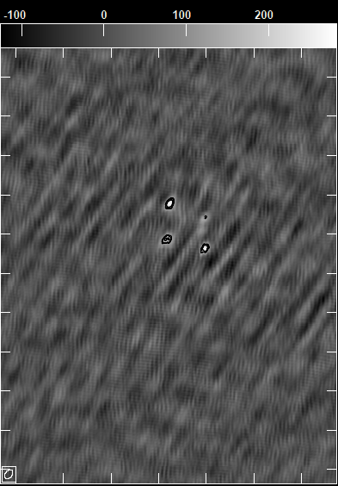
LIRGI observations with EVN

Slide 44
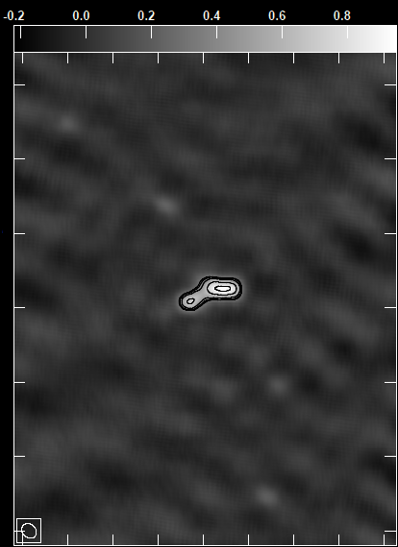
LIRGI observations with EVN

Slide 45
IR/radio relation
Condon et al. 1991

Slide 46
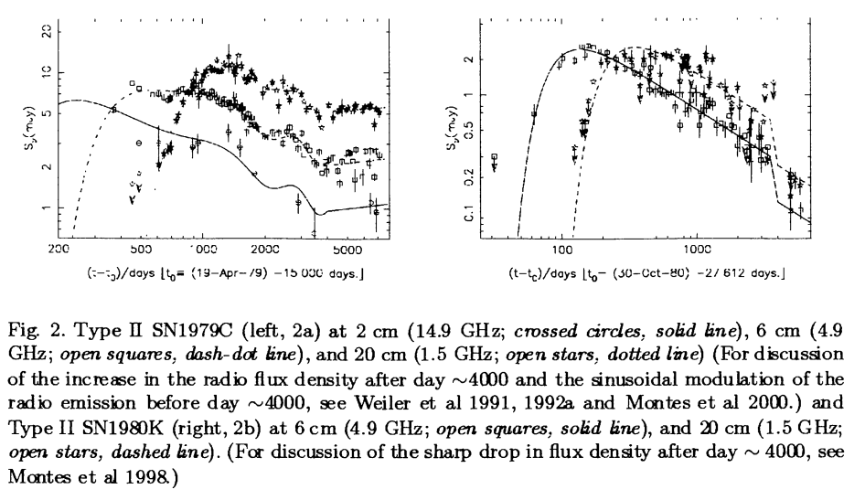

Slide 47
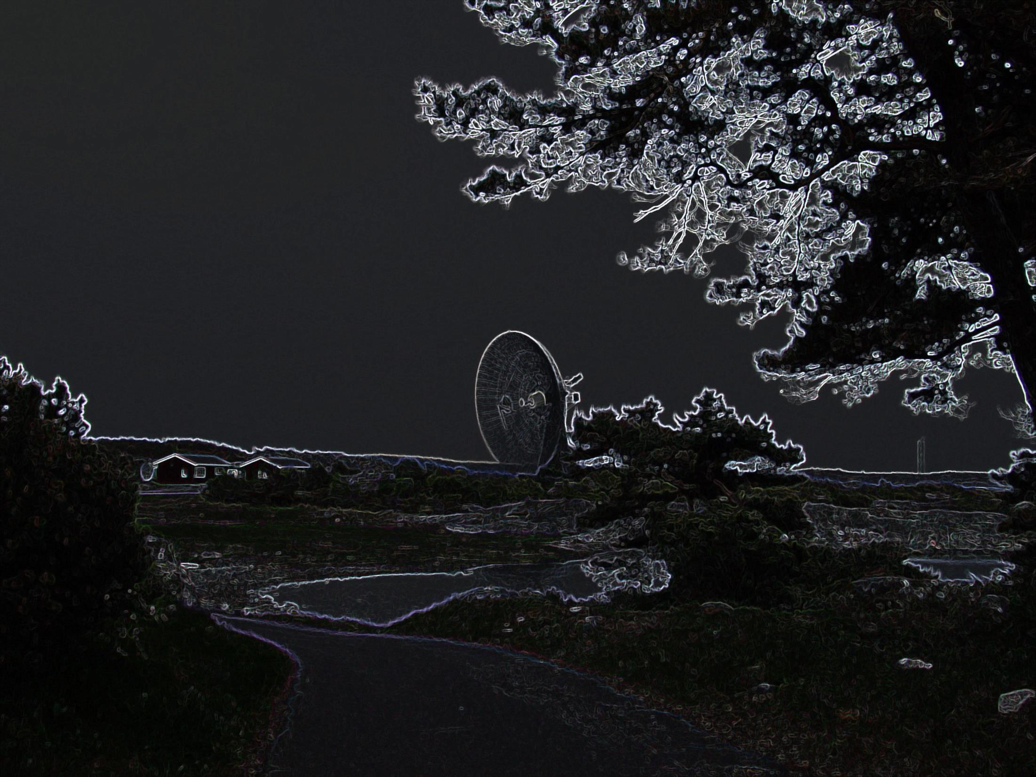
THANK YOU!

